Slide 1


e-Mobility for All
2023
RASD & DD
Riccardo Bravin Elia Feltrin
Milano,
17 febbraio 2023

Slide 2
RASD
Requirements Analysis and Specification Document

Slide 3
Goals
RASD
G1 | Allow user to pay for a charge
G2 | Allow user to book a charge
G3 | Allow user to register to the eMSP system
G4 | Allow user to know about charging station prices and special offers
G5 | Allow user to perform a charging process
G6 | Allow user to make reservations
G7 | Allow CPMS to manage manually or automatically the power input/output of the charging station
Notes:
The systems goals encompass all the functionalities required by the client. More specifically the system should be able to handle registrations, bookings and payments while also enabling the user to know about charging station positions, prices and special offers. The CPMS subsystem instead should handle reservations and all the power delivery and retrieval of the charging stations.
Goal 5 joins these two sections which need to communicate to accomplish a common task, performing a charging process.
This is the process we will now see as a use case.

Slide 4
Use case Charging Process
RASD
Actor: User
Entry Conditions: reservation has been previuosly made
Event Flow:
User selects desired reservation from list on eMSP app that cumunicate the user identity and the selected charging column to the CPMS
User plugs the car and the charging process start. The user will be notified 10 minutes before the end of the process
CPMS comunicate the final bill to the user throught the eMSP app, that makes the payment
If the charging spot is freed before the end of the reservations, the CPMS makes the remaining time available to other users
Notes:
The user is the actor which needs to have previously made a reservation then the event flow follows 4 main sections…

Slide 5
Most important Requirements
RASD
R6 | eMSP shall allow registered users to make a reservation to a specific CS at a specific date
R7 | eMSP must show registered users correct positional data and nearby charging stations
R18 | CPMS must be able to automatically decide how to manage its own battery and net power
R19 | CPMS must be able to automatically decide which DSO buy energy from
R20 | CPMS must be able to answer eMSP requests for free timeframes and relative prices
Notes:
The most important requirements are, for wat concerns the eMSP, finding the wanted or nearby charging station while also being able to make reservations at specific timeframes for a given user, and for the CPMS, the automation and management of the charging area power and reservations. The CPMS needs to also be able to handle requests from the eMSP of informations about free timeframes and charging prices

Slide 6
Most important Assumptions
RASD
D1 | During the night hours energy is less expensive
D3 | After a vehicle reserved time-frame finishes the charging socket is freed in 5 minutes
D[5-10] | There exists APIs that enable comunication between the different parts of the systems external modules
Notes:
The most important assumptions are the ones the concern the CMPS management such as the fact that energy during the night is less expensive, this is for power handling purposes, and that after a vehicle timeframe ends or the car finishes charging, the user frees the charging socket and spot in 5 minutes after the end.
The last assumption is an aggregate of all assumpions that entail the use of an API to manage external services such as payment and DBMSs

Slide 7
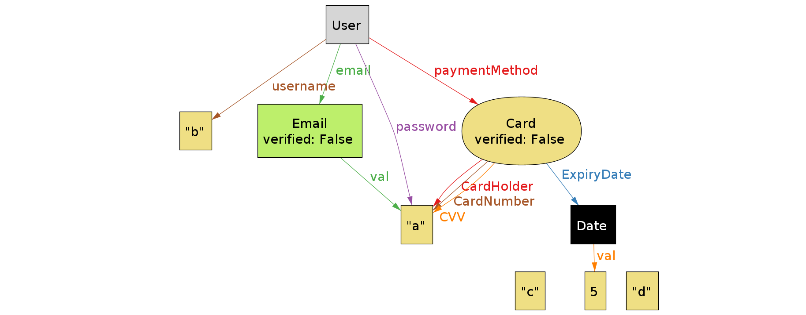
Alloy model eMSP World
RASD
Notes:
With the model we want to show how the relations between systems and objects is coherent with the real world and all elements needed for the implementation of the software can cohexist in the modeled world There also are reservations that are the entity that links the CPMS and eMSP worlds by connecting users and charging stations with one another

Slide 8
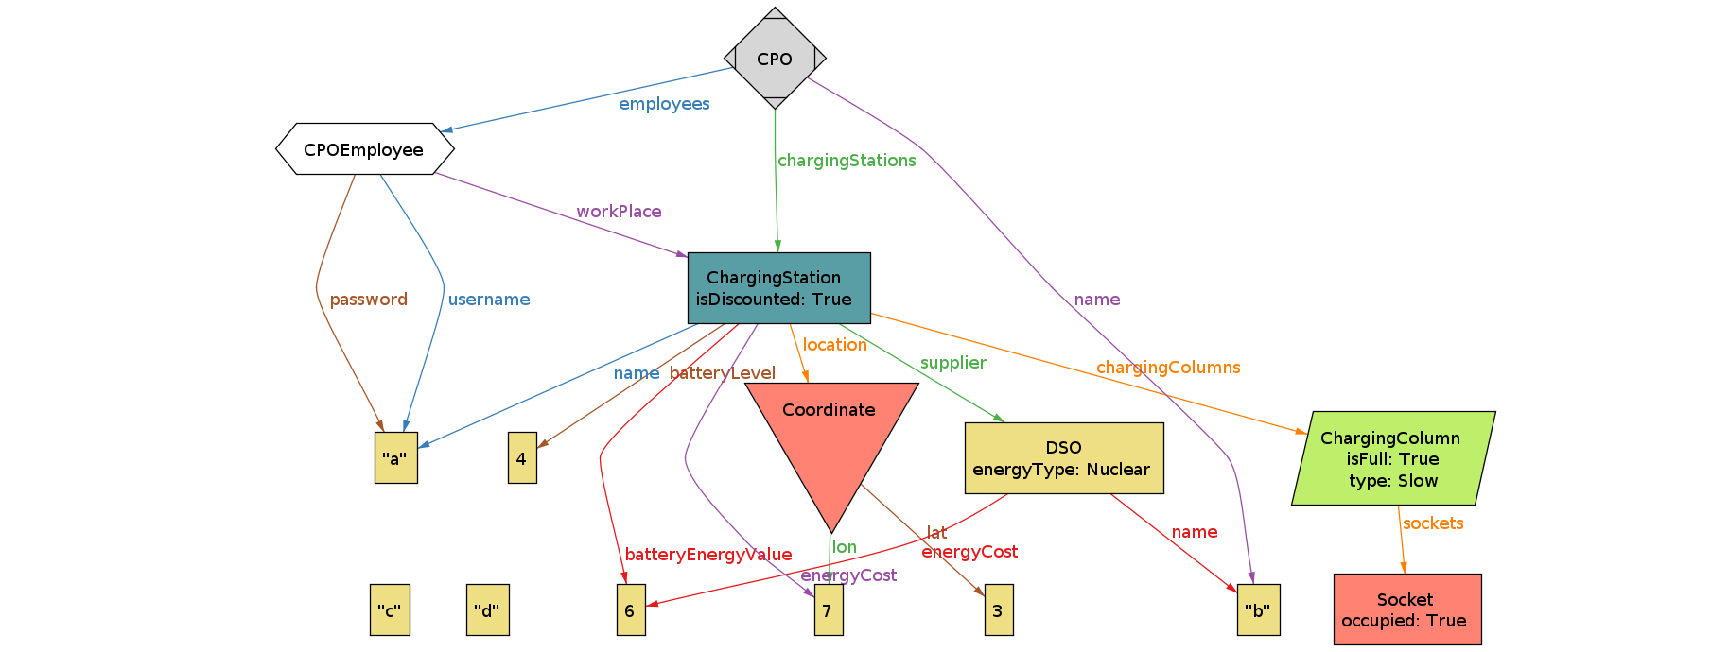
Alloy model CPMS World
RASD
Notes:
With the model we want to show how the relations between systems and objects is coherent with the real world and all elements needed for the implementation of the software can cohexist in the modeled world There also are reservations that are the entity that links the CPMS and eMSP worlds by connecting users and charging stations with one another

Slide 9
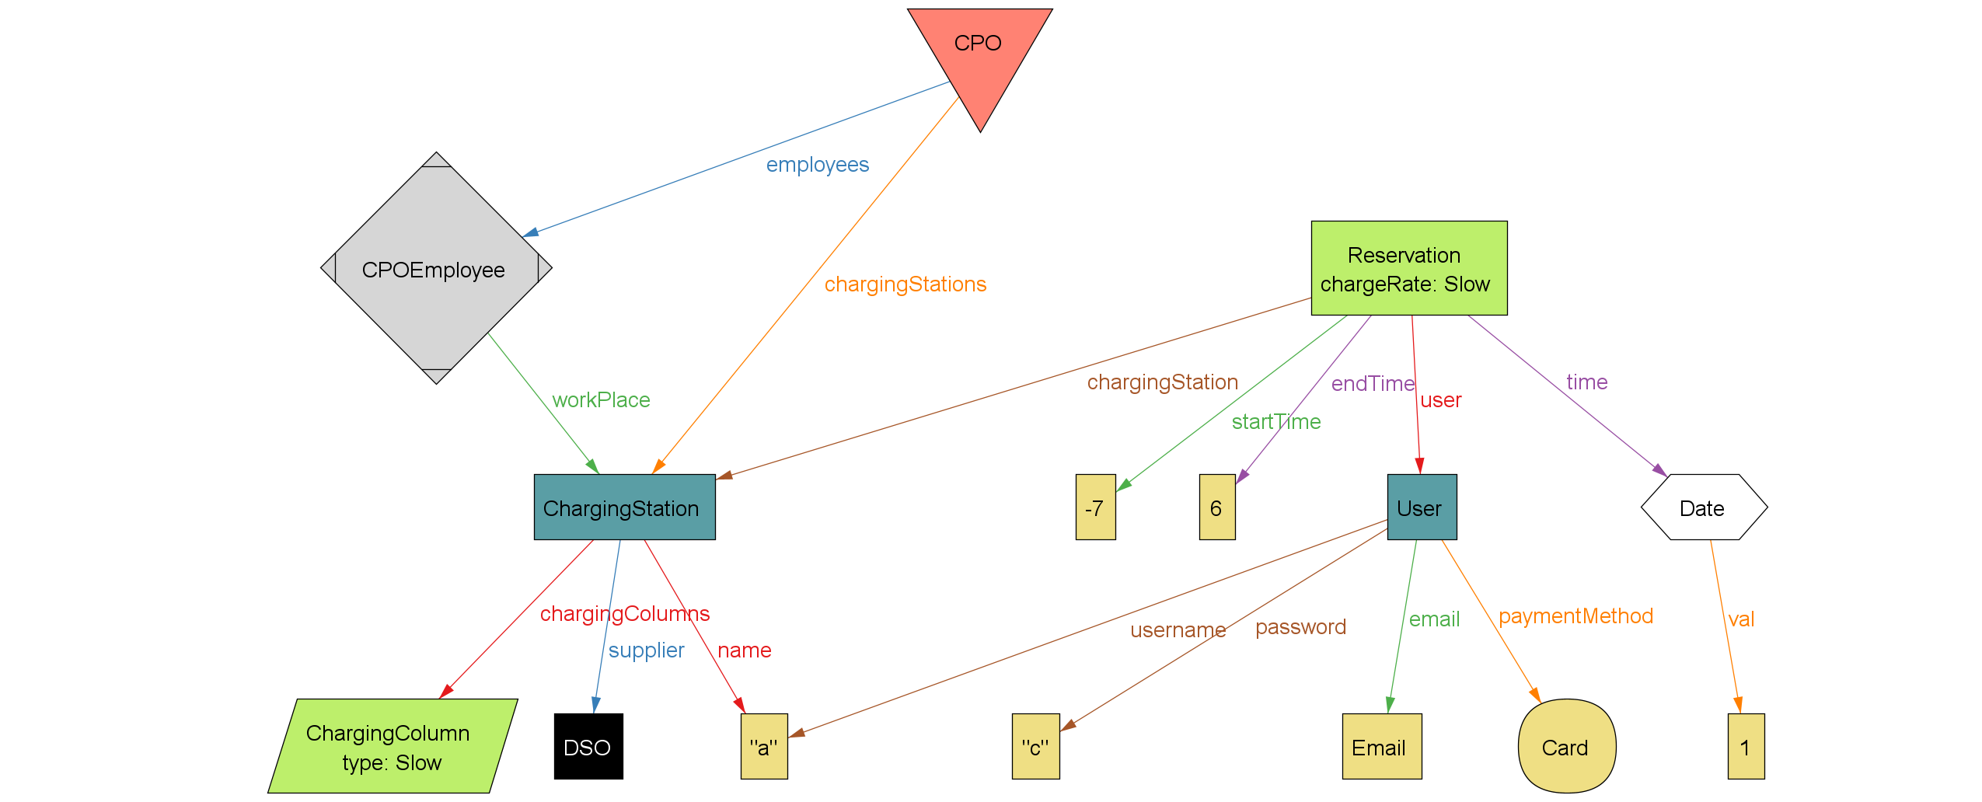
Alloy model Reservations
RASD
Notes:
With the model we want to show how the relations between systems and objects is coherent with the real world and all elements needed for the implementation of the software can cohexist in the modeled world There also are reservations that are the entity that links the CPMS and eMSP worlds by connecting users and charging stations with one another

Slide 10
DD
Design Document

Slide 11
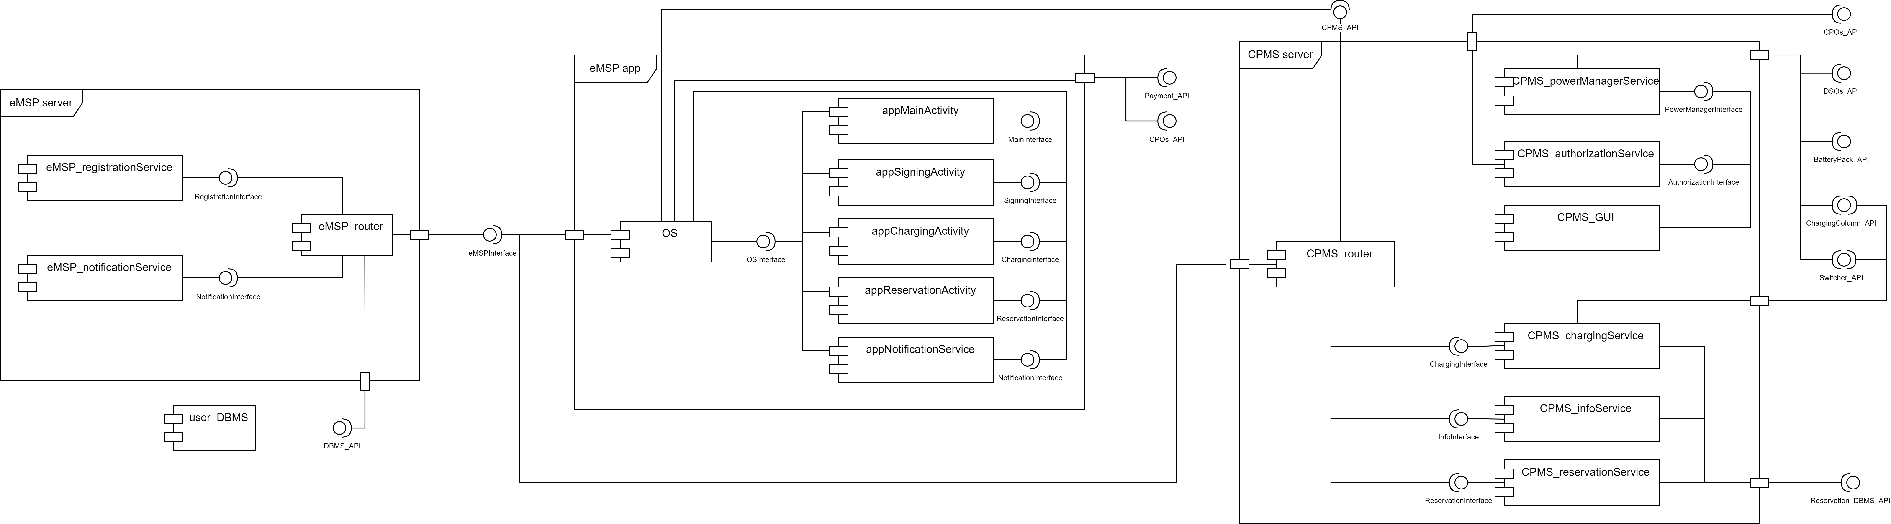
System components view
DD
Online non funziona niente quindi l'ho sul desktop
Notes:
eMSP app:
1)management of reservation
2)charging station information retrieval
Client for CPMSserver, client and subsciber for the eMSPserver
eMSP server:
1)notification management (handled has publisher-subscriber system)
2)user registration and login
Dispatcher and server for the eMSP app
Dispatcher for the CPMS server
CPMS server
2)reservation management and informaton service for eMSPapp
1)charging station management and CPMS employee interaction
Publisher fot the eMSP server, server for the eMSP app
The main components of the system are the eMSP app and CPMS server which communicate both together and with a eMSP server which handles mostly redirections and the interactions with the user DMBS. The eMSP app handles most of the businnes logic while also providing the user with a graphical interface with wich to interact. The CPMS server instead handles internally the interface through which the employees manage the charging station while also handling all internal automations of power and reservations

Slide 12
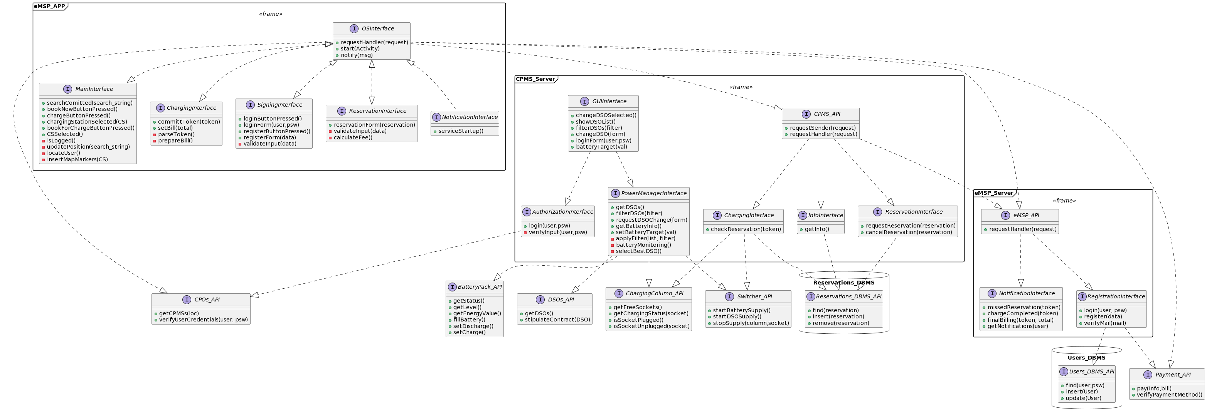
Component interfaces
DD
Ce l'ha bbrav sul desktop

Slide 13
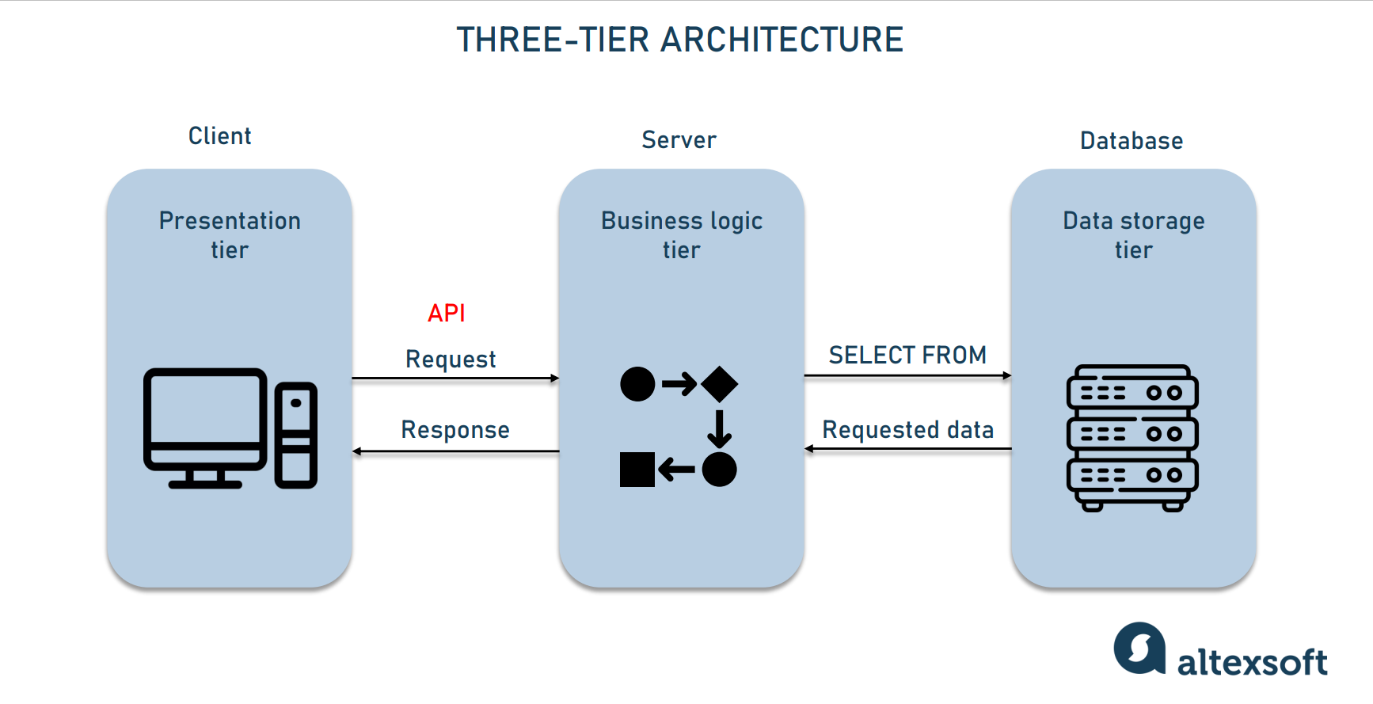
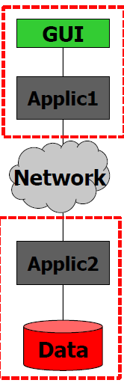
Architectural style and patterns
DD
Elimina logo altexsoft
Notes:
Three layer architecture for both CPMS and eMSP systems
eMSP
Presentation and business logic integrated in the varius activities, since embedded OSs enables this behaviour
Part of the bisness logic is implemented in the eMSP server due to the necessicity of manage connected devices.
Datastorage: user_DBMS, managed by eMSPserver
CPMS:
Presentation (for the employee): CPMS gui
Business logic: all the other components
Datastorage: reservationDBMS
Describe how the things are divides: eMSP has an APP for the client part, businnes logic is partially inside the app and part on the server and the database is present connected to the server for storage purposes
The CPMS has instead a big sistem that is subdivided in higher level sections with which the internal client interacts while the businnes logic layer takes care of the CS internal power management and interaction with the DBMS for the reservation

Slide 14
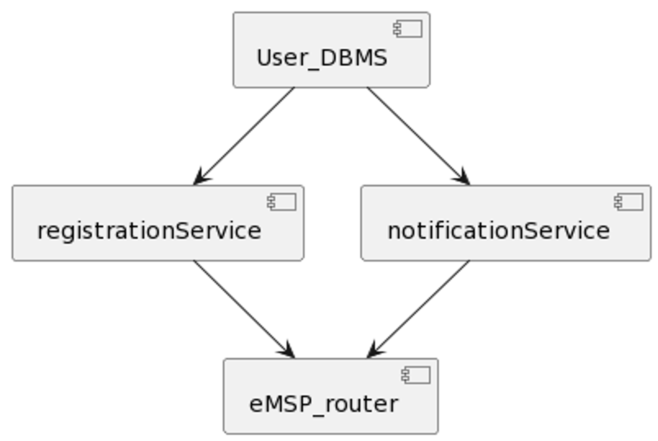
Implementation, integration and tests plan eMSP server
DD
Notes:
For the eMSP_server subsystem the integration plan choosen is the bottom-up approach, since both services have a clear dependency on the user_DBMS.
BOTTOM UP

Slide 15
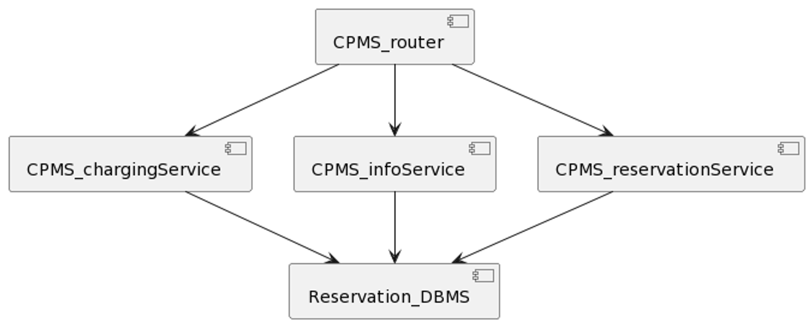
Implementation, integration and tests plan CPMS server – part 1
DD
Notes:
CPMS_server can be divided into two parts: the first composed by the CPMS_graphics, CPMS_authorizationService and CPMS_powerMangerService, and the second one composed by CPMS_router, CPMS_infoService, CPMS_chargingService, CPMS_reservationService and reservation_DBMS. This two parts can be implemented either in parallel or in sequence, each one following a top-down approach described in the following images.
TOP DOWN – either in parrallel or in series with part 2

Slide 16
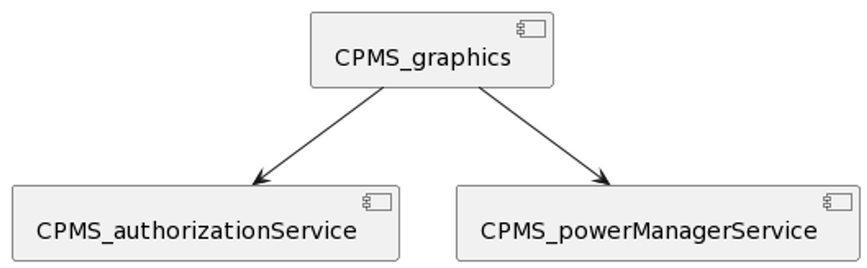
Implementation, integration and tests plan CPMS server – part 2
DD
Notes:
CPMS_server can be divided into two parts: the first composed by the CPMS_graphics, CPMS_authorizationService and CPMS_powerMangerService, and the second one composed by CPMS_router, CPMS_infoService, CPMS_chargingService, CPMS_reservationService and reservation_DBMS. This two parts can be implemented either in parallel or in sequence, each one following a top-down approach described in the following images.
TOP DOWN

Slide 17
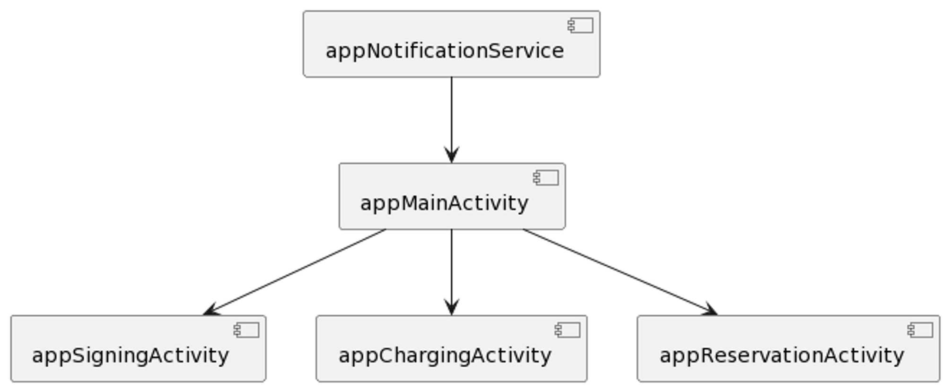
Implementation, integration and tests plan eMSP app
DD
Notes:
The eMSP_app can be also implemented following a top-down approach described in the following image.
TOP DOWN

Slide 18
Please note that the use of "it" in the previous slide is used to provide a neutral and inclusive language.
Nome Cognome Autore
Ruolo autore presso il Dipartimento
CONTATTI
Tel. +39 02 2399 XXXX
nome.cognome@polimi.it
www.deib.polimi.it

